Slide 1

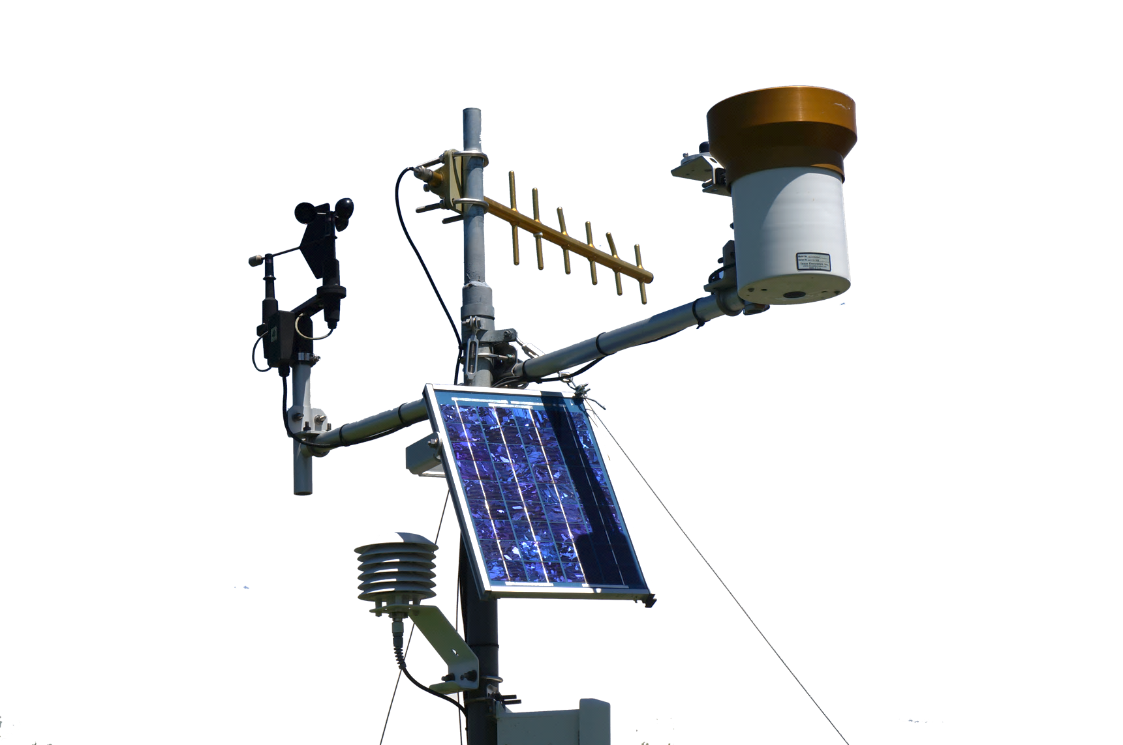
Science for Utah’s Water Future
Amber Spackman Jones iUTAH Data Manager
Utah Water Research Laboratory Utah State University
Notes:
Acknowledge many that have contributed to this effort.

Slide 2


EPSCoR
Experimental Program to Stimulate Competitive Research
Build statewide research capacity
Enhance economic competitiveness and sustainability
Strengthen STEM workforce
Notes:
iUTAH is an EPSCoR project, which is funded by NSF. These are not typical research projects- they are focused on building research capacity and infrastructure.
EPSCoR’s goals and roles in Utah.
Utah’s water resources are critical to the state’s industries and economy- hence a project focused on water sustainability.
Idaho and Wyoming are also EPSCoR states- you may be familiar with projects in those states.
Utah graduated from EPSCoR eligibility, meaning that iUTAH as we know it will not be directly renewed from NSF, so we have been working on sustainability of the research and infrastructure that we have developed.

Slide 3
iUTAH Water Quality Research
Environmental observatory with real-time data and synoptic samples
Human imprint on nutrients, metals, and organic matter
Groundwater surface water interactions
E.Coli distributions and microbial source tracking
Notes:
The core of iUTAH water quality monitoring is our environmental observatory. From that hub, we have a number of branching research efforts.
I’ll focus on the core in this presentation and touch on some of these branches.

Slide 4
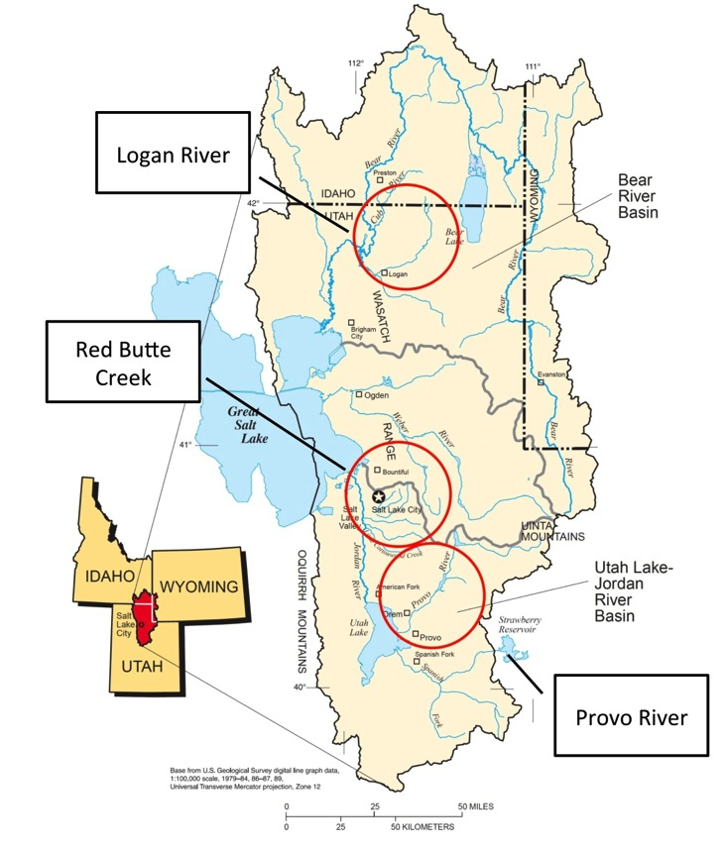



GAMUT: Gradients Along Mountain to Urban Transitions
Three watersheds instrumented from a mountain to urban gradient
Watersheds with similar water source (high elevation snow) but different land use transitions
Mountain to Valley Transition
Fundamental Aquatic Sites
Enhanced Aquatic Sites
Climate/Terrestrial Sites
Notes:
GAMUT started with an idea. Standardize in situ data collection at aquatic and terrestrial climate sites in three different watersheds.
Three different watersheds that represent differing types and patterns of urbanization.
The streams originate with mountain snowpack, flow through canyons, and exit to populated valleys. In all cases, we have mountain water being used by urban people.

Slide 5
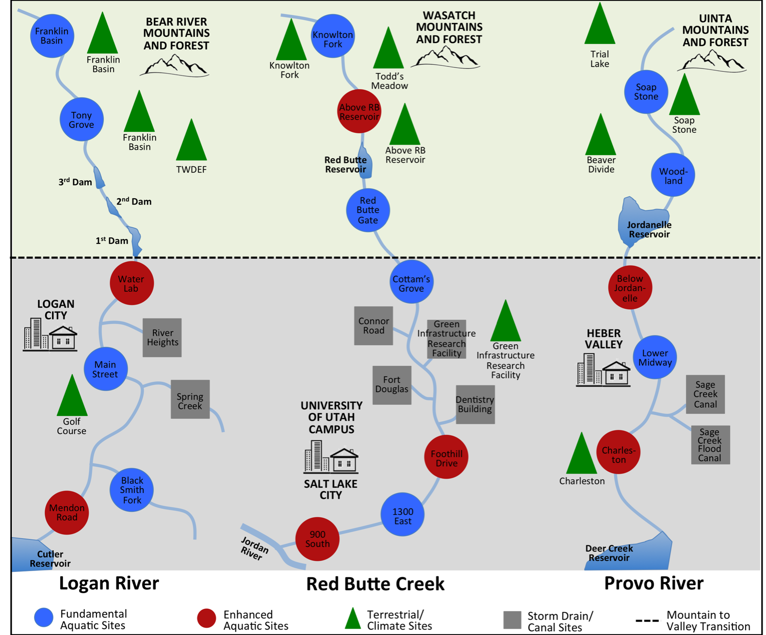

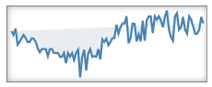
GAMUT: Gradients Along Mountain to Urban Transitions
40 sites
2000 data series
174 million+ values over 3.5 years
Notes:
Each watershed includes several aquatic, climate and storm drain sites.

Slide 6
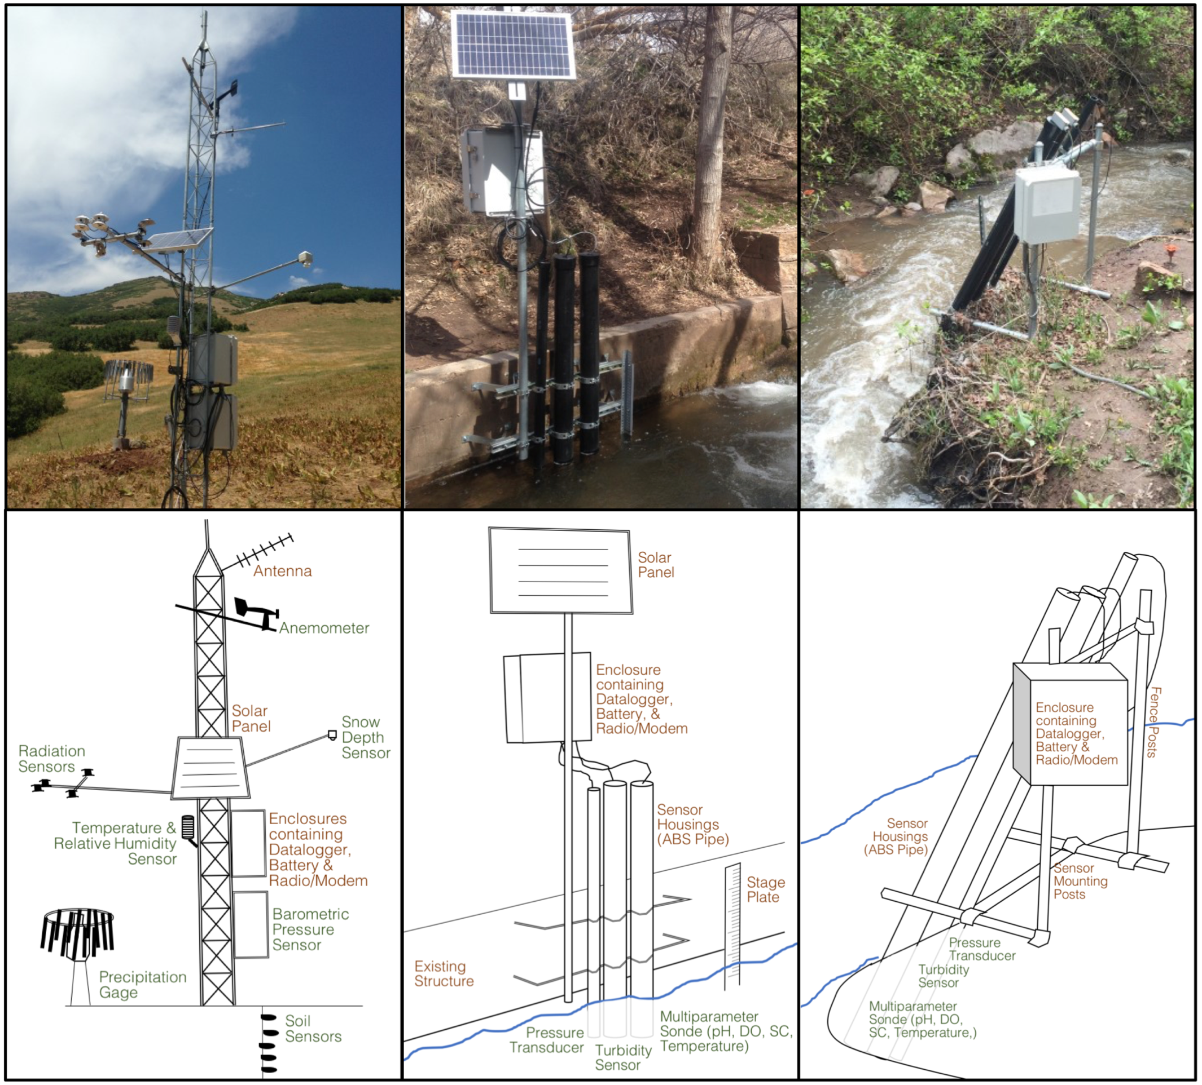
GAMUT: Gradients Along Mountain to Urban Transitions
Measures aspects of water inputs and outputs and water quality over mountain-to-urban gradient
Mix of aquatic and terrestrial in situ and re-locatable sensors
Water quality variables:
Temperature
pH
Specific Conductance
Dissolved Oxygen
Turbidity
fDOM
Phycocyanin
Nitrate
Notes:
Basic vs. Enhanced wq sites

Slide 7
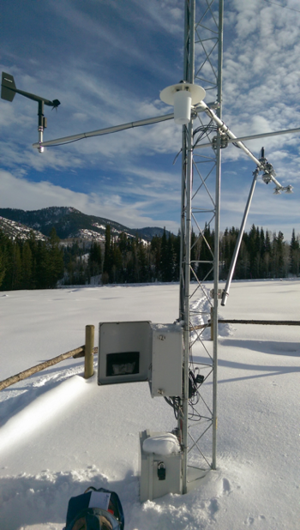
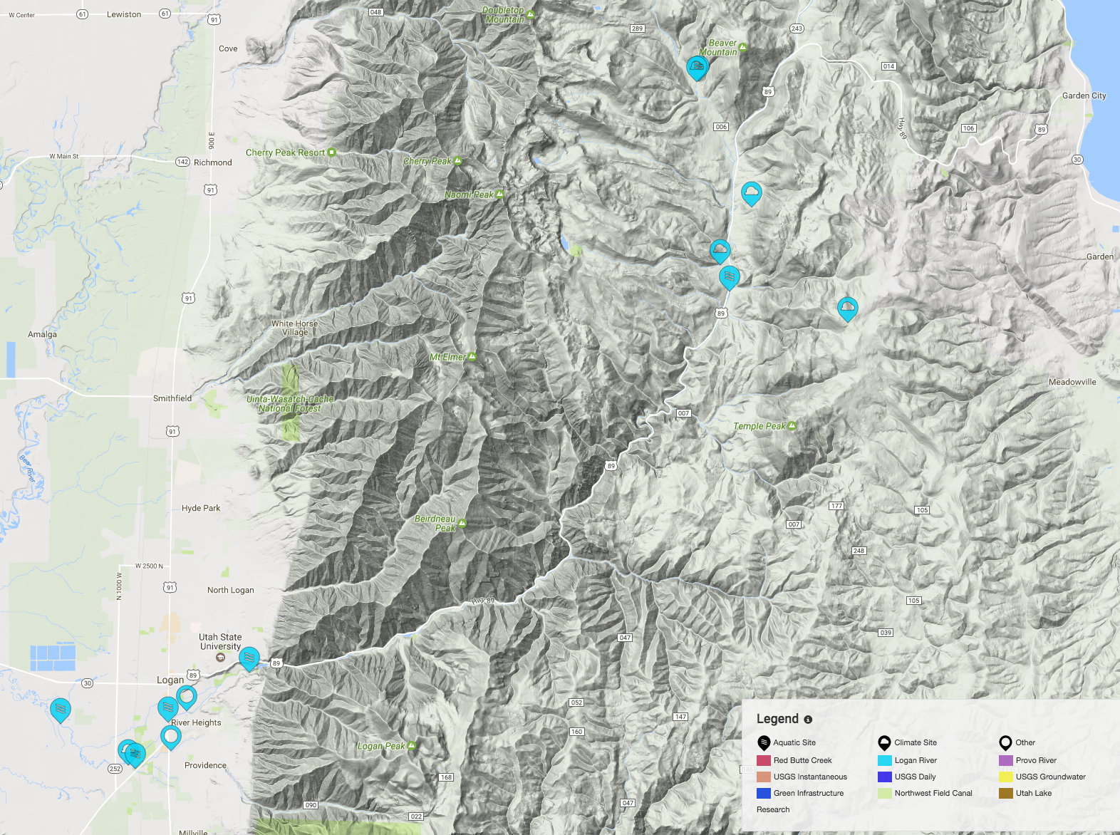
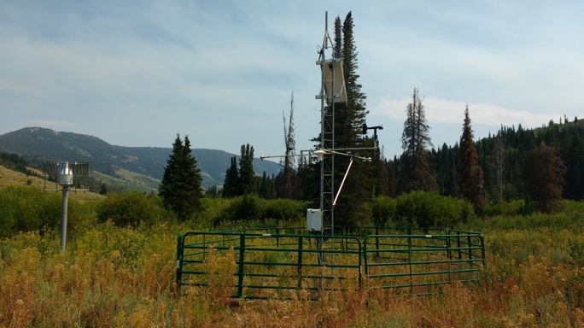
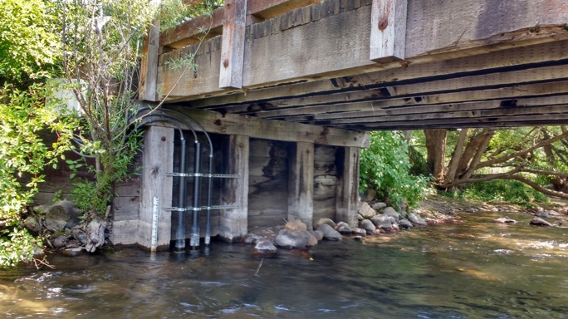
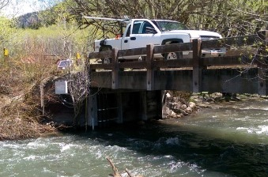
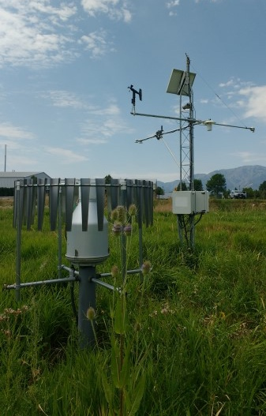
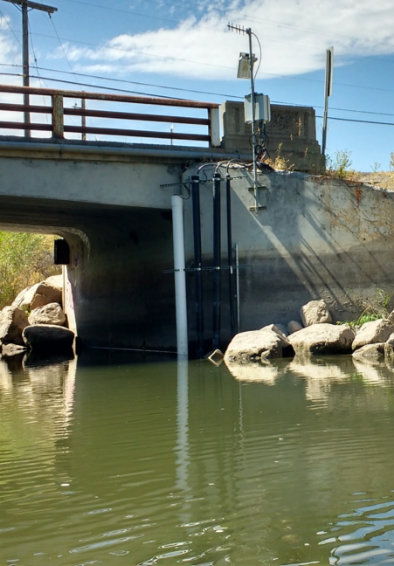
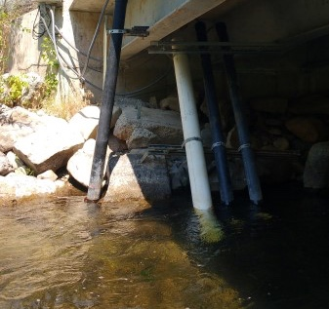
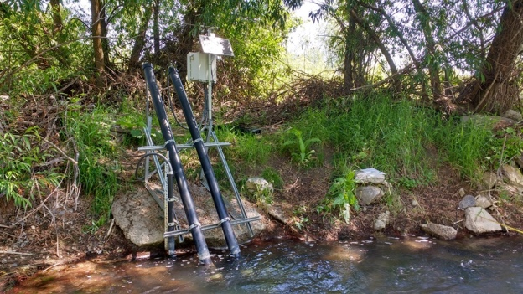
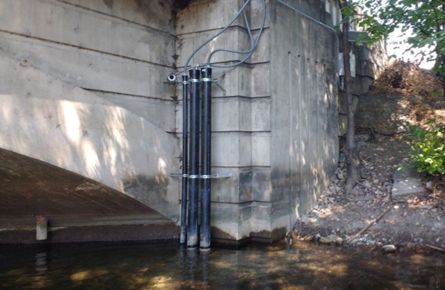
GAMUT: Gradients Along Mountain to Urban Transitions
Notes:
In the Logan River watershed, we have several climate stations in the high and mid elevation mountains of the upper watershed.
A few basic aquatic sites in the upper watershed.
An advanced aquatic site after the river exits the canyon, another site in town, and an advanced aquatic site at the downstream end of the river.
A climate site in Logan, and we’ve added a site on the BlackSmith Fork and instrumented two stormdrains with flow modules.

Slide 8
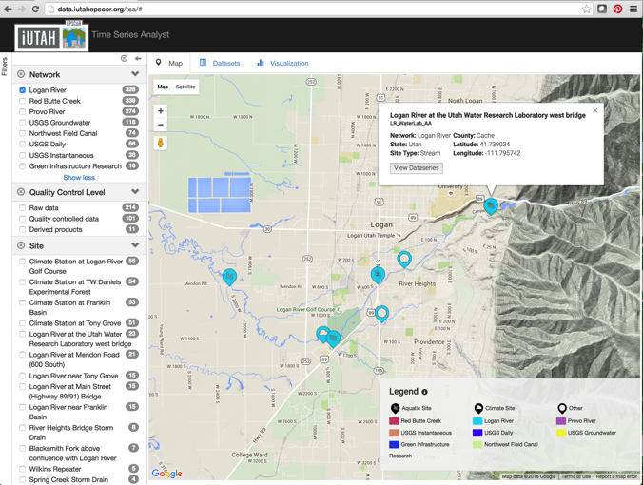
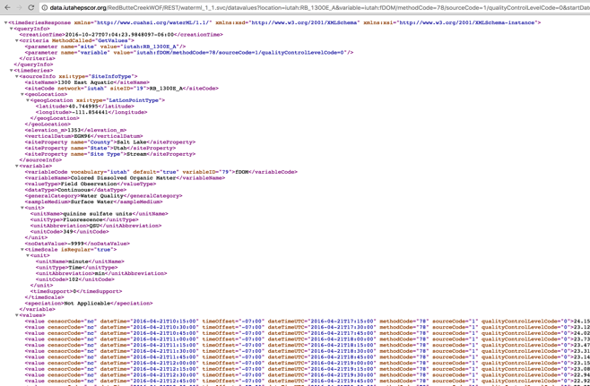
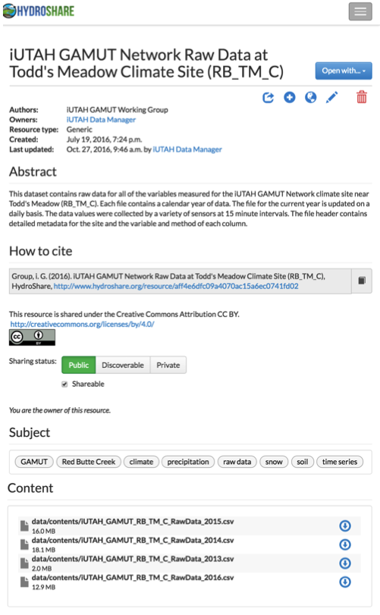
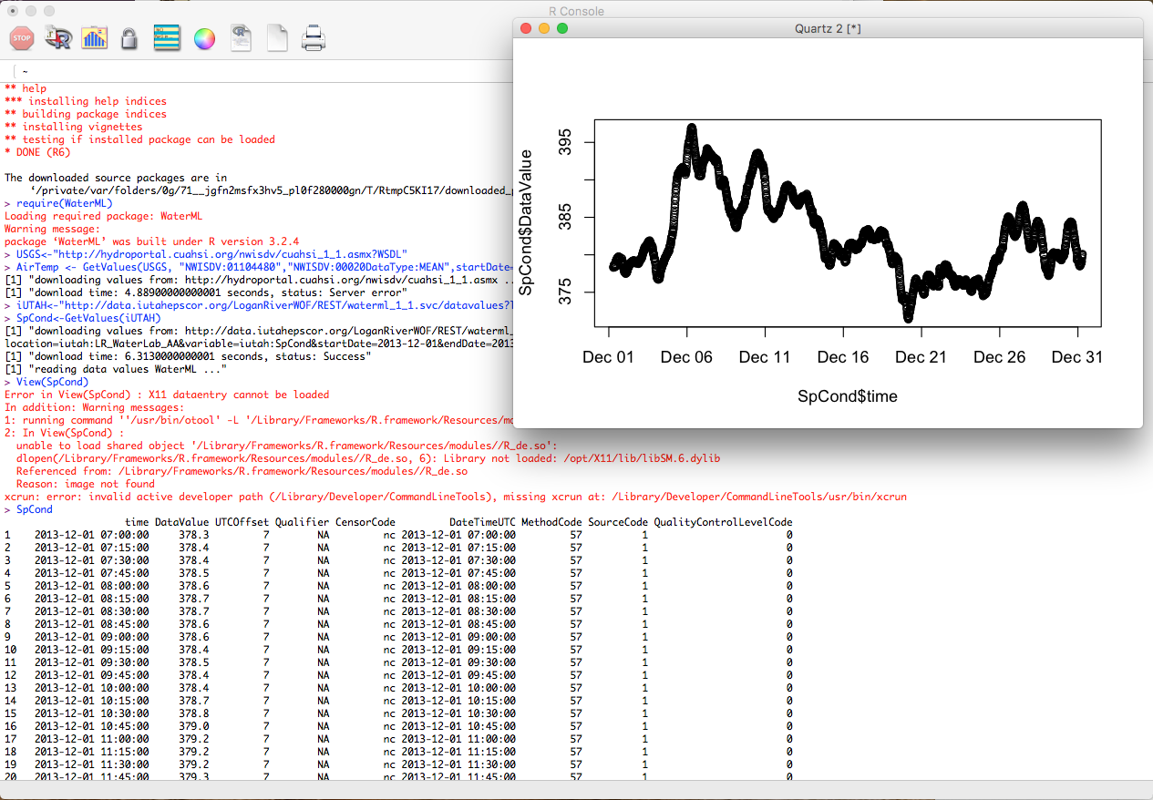
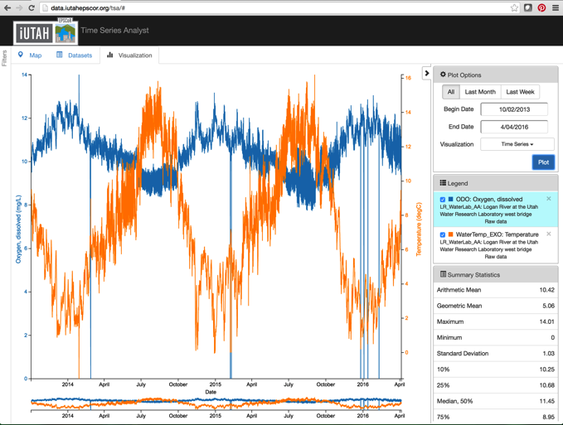
GAMUT: Accessing Sensor Data
HydroShare: Data available in flat files (csv) and updated daily
Time Series Analyst: Web interface, map and plot tools, and data export
Web Services: Programmatic data access
Notes:
GAMUT data are available via several mechanisms.
HydroShare is a data repository where we are publishing data in flat files.
The time series analyst web interface provides map based data discovery, data export,and plotting tools.
The GAMUT data are also published via web services, and registered with the CUAHSI Water Data Center, which makes them available in a national context alongside other data. Web services gives programmatic access and can be called from Python or R or choose your favorite programming interface.

Slide 9
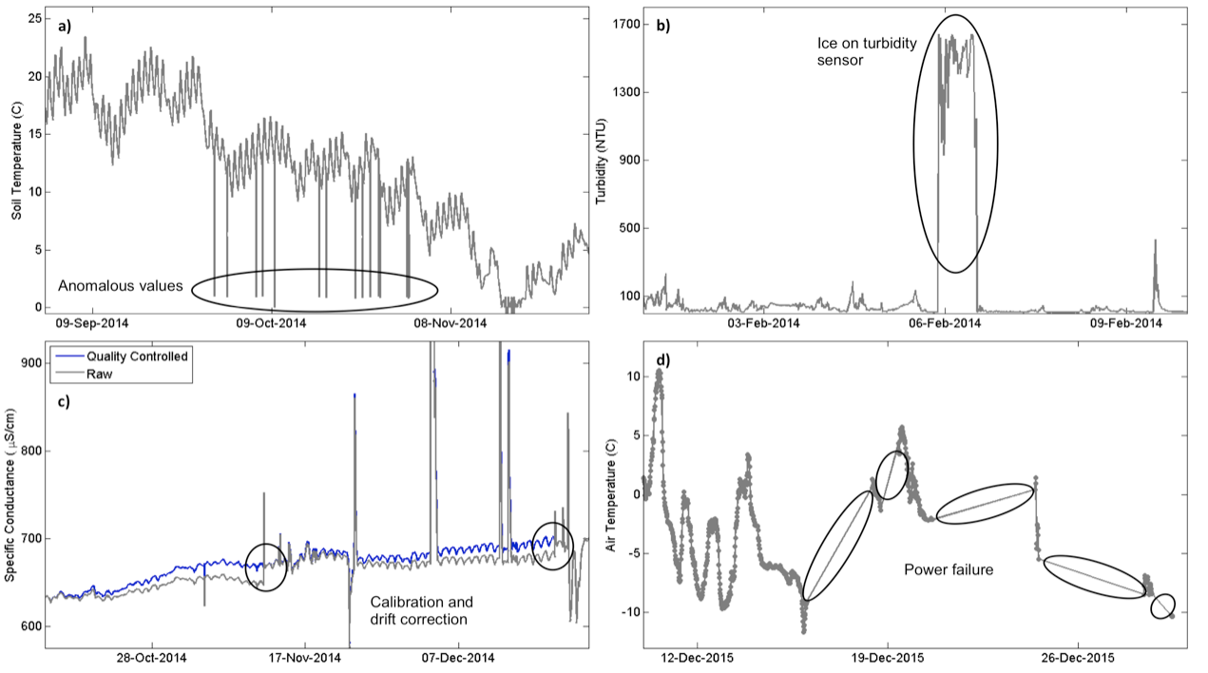
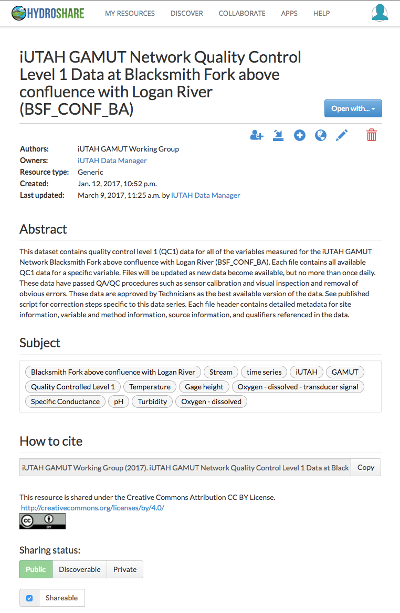
GAMUT: Quality Control of Sensor Data
High frequency data require post processing
Variables sorted into tiers depending on their priority
Status: All complete through 2015, most complete through 2016
Work is ongoing
Notes:
GAMUT Technicians perform data post processing to generate approved, quality controlled datasets that remove erroneous outliers, correct for sensor drift, remove periods of sensor malfunction, etc. This image shows typical quality control scenario.
This is no small effort- ongoing effort.
Quality controlled data may be accessed similarly to raw GAMUT data as I just described.

Slide 10
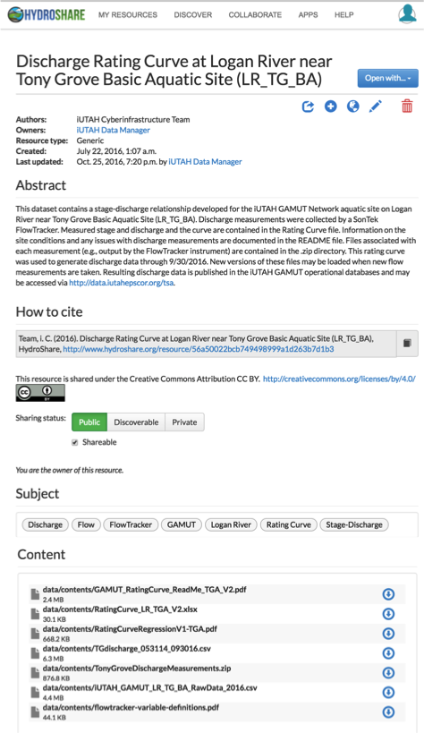
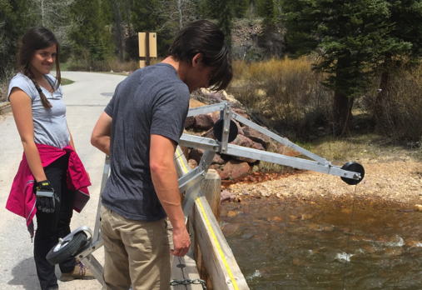
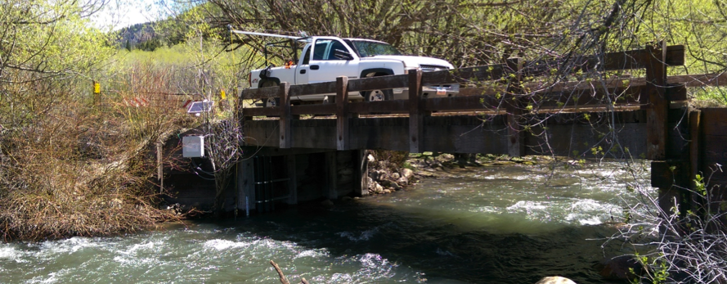
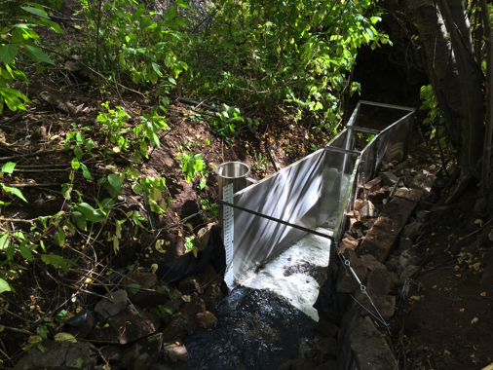
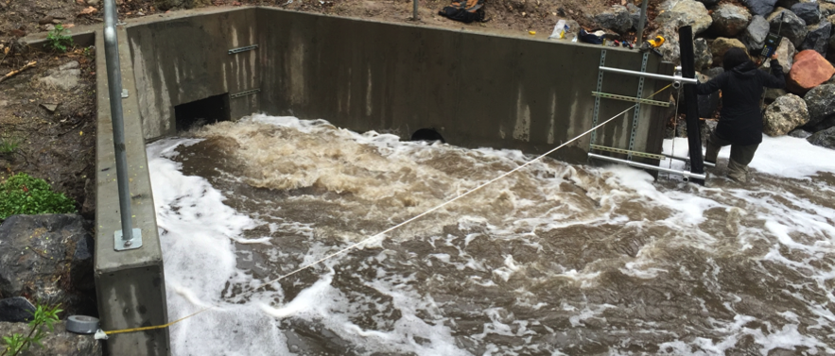
GAMUT: Discharge Data
Variety of methods implemented to manually measure discharge
Stage-discharge relationships shared to HydroShare
Time series of discharge accessible with other GAMUT data
Notes:
For all aquatic sites, we’ve developed stage-discharge relationships. These, along with information on each discharge measurement and how the relationship was developed are packaged as a resource and shared on HydroShare. Furthermore, time series of discharge are accessible alongside other GAMUT data.

Slide 11
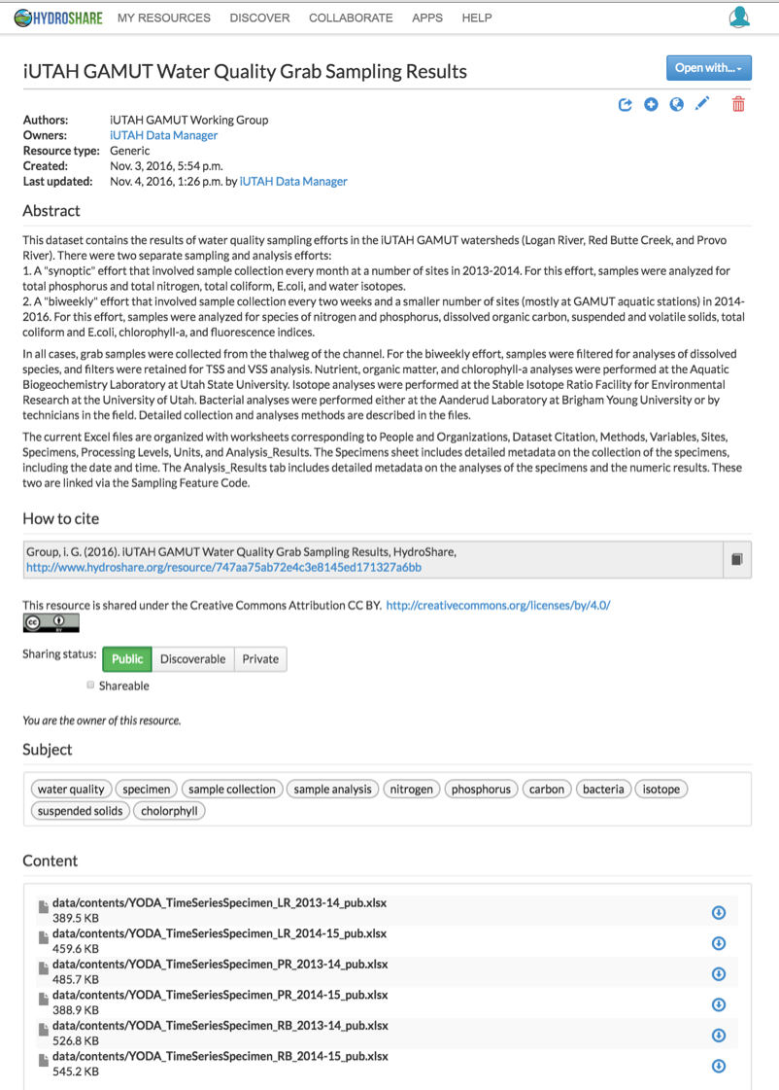
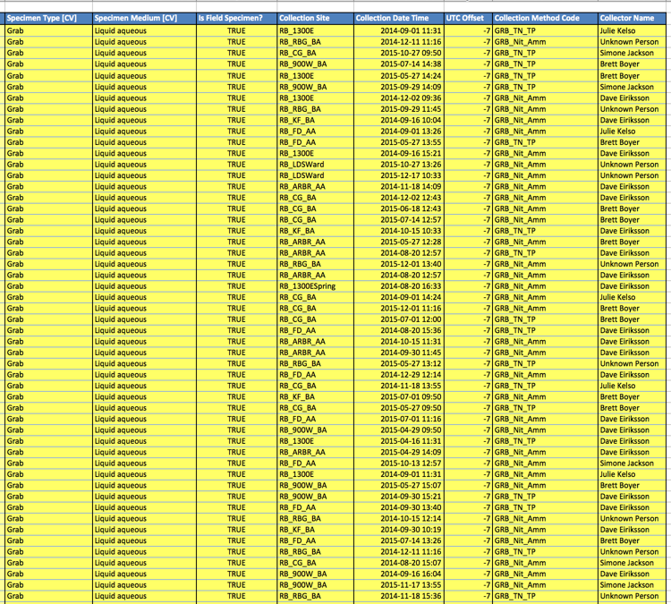
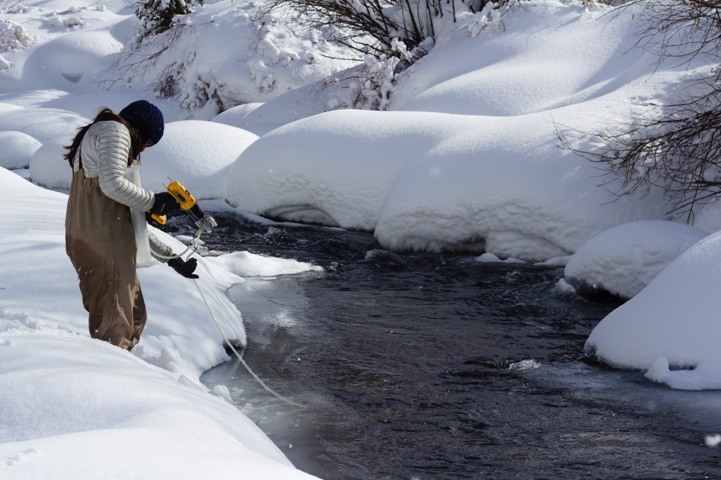
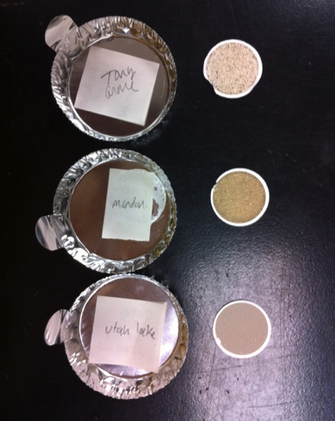
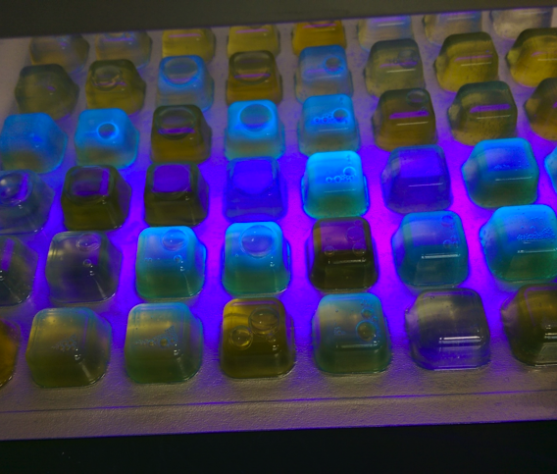
GAMUT: Grab Sample Results
Two efforts with different variable sets:
Monthly sampling: 2013-2014
Biweekly sampling: 2014-2016
Status: Most results available through 2015
Variables: TSS, VSS, species of Nitrogen and Phosphorus, Total Coliform, E.coli, DOC, Fluorescence, Chlorphyll-a, Isotopes, Ions
Notes:
Along with the sensor data, iUTAH has collected and analyzed water quality samples for various parameters. We’ve published these results to HydroShare.
We’ve worked to compile results into an excel file, which is a preliminary format. We’ll be building some tools and a viewer to provide a more approachable format.
Efforts, status, variables.

Slide 12
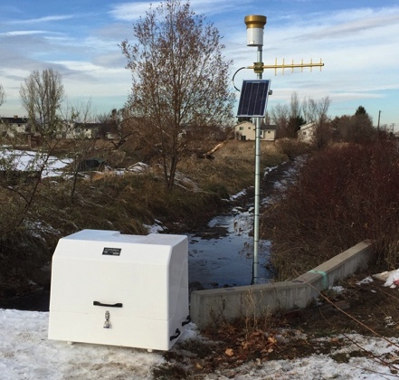
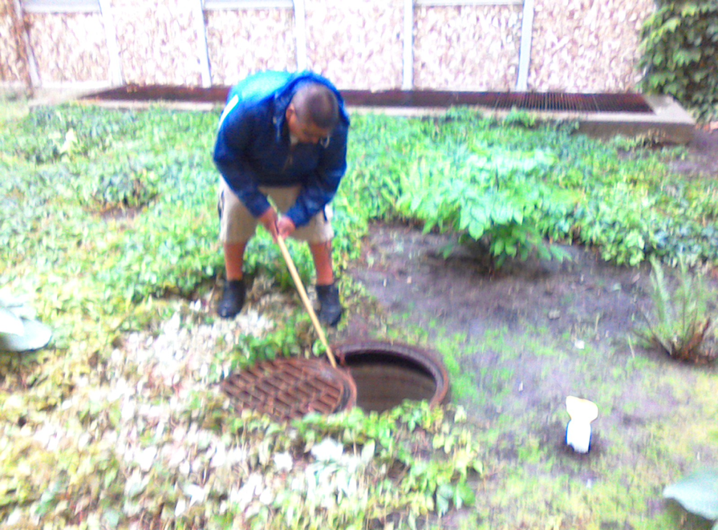
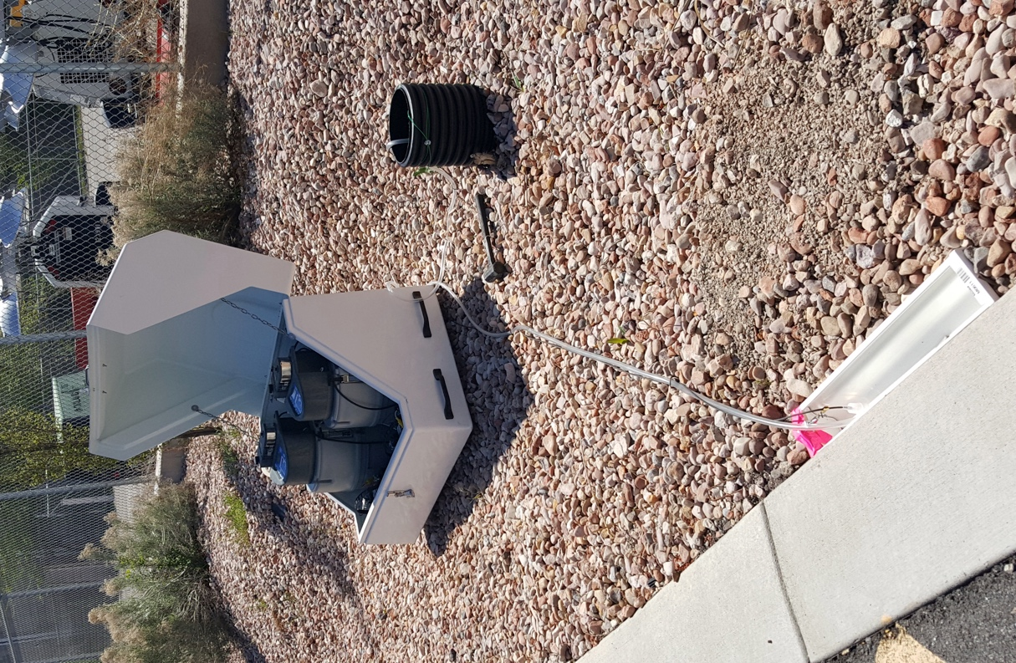
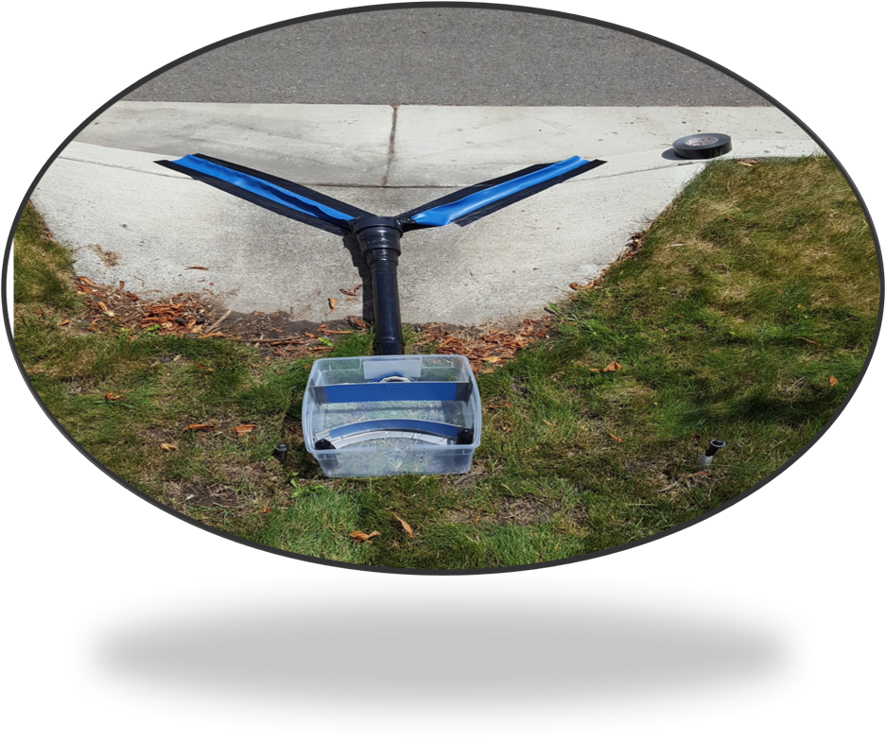
GAMUT Extensions: Additional WQ Efforts
Stormwater/canal network
Residential stormwater and stormwater harvesting
Notes:
So, I’ve covered the core water quality data being collected and compiled by iUTAH. There are also a number of dispersed efforts being conducted where researchers are piggybacking on GAMUT infrastructure to expand research questions.
Stormwater/canal: Jeff Horsburgh’s research team has instrumented a combined stormwater/canal system in Logan similar to GAMUT aquatic sites. We’ve also collected water quality samples here and are working on the development of surrogate relationships for TSS/phosphorus as well as analysis of organic matter.
Residential stormwater: Ryan Dupont and others have instrumented a green infrastructure system where they are studying plant uptake and pollutant removal. Using GAMUT infrastructure.

Slide 13
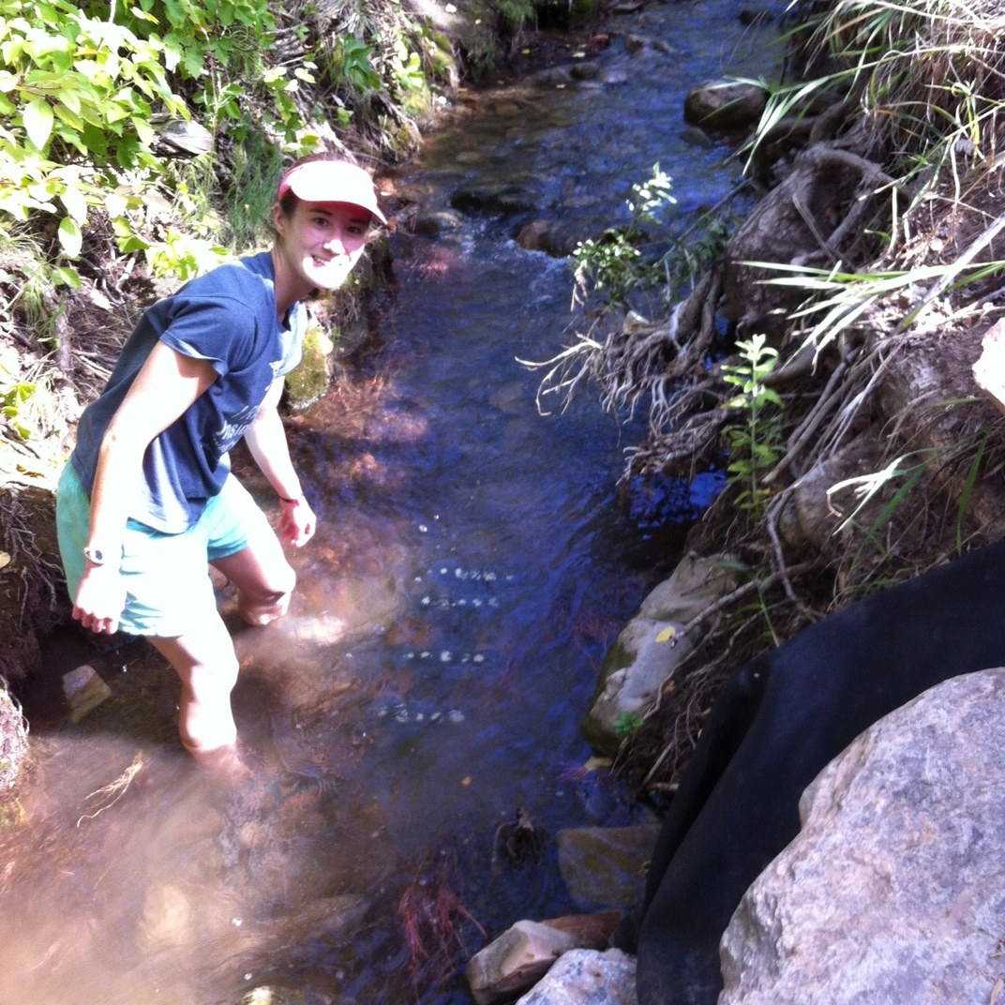
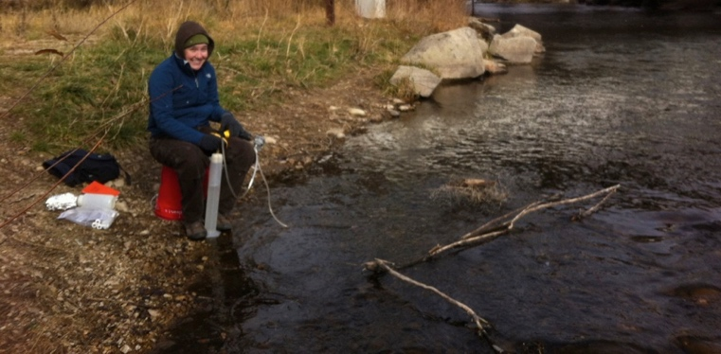
Water Quality Research in iUTAH
Nutrient limitation of benthic algae along mountain-urban gradients
Can we estimate nutrient saturation concentrations?
How do bacterial communities change along mountain to urban gradient?

Slide 14
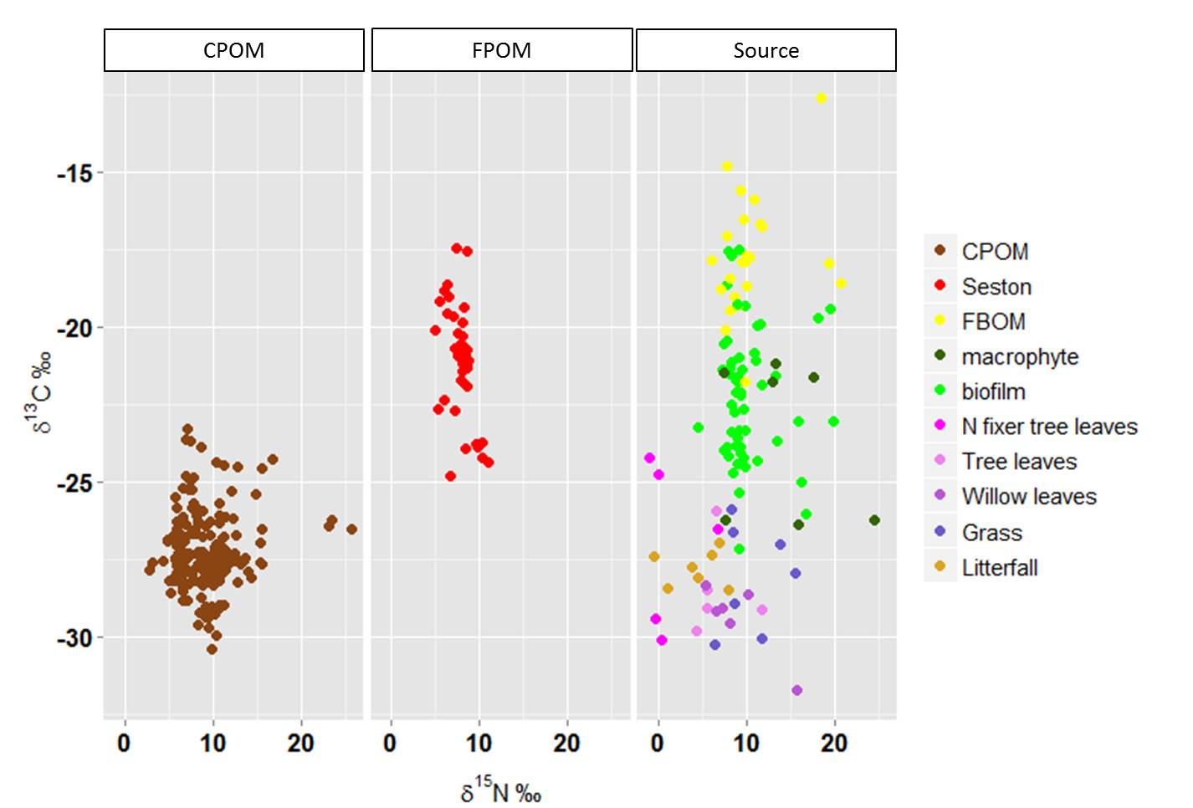
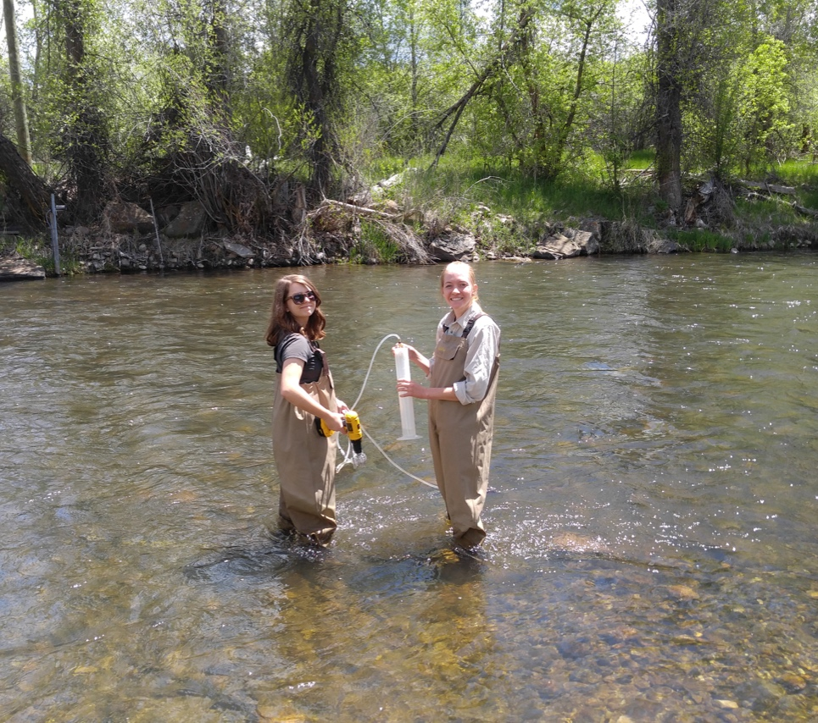
Water Quality Research in iUTAH
Sourcing organic matter using isotopes
CPOM and FPOM have different sources
Notes:
Identify terrestrial, instream or urban sources. She plans to use dissolved oxygen data to model metabolism.

Slide 15
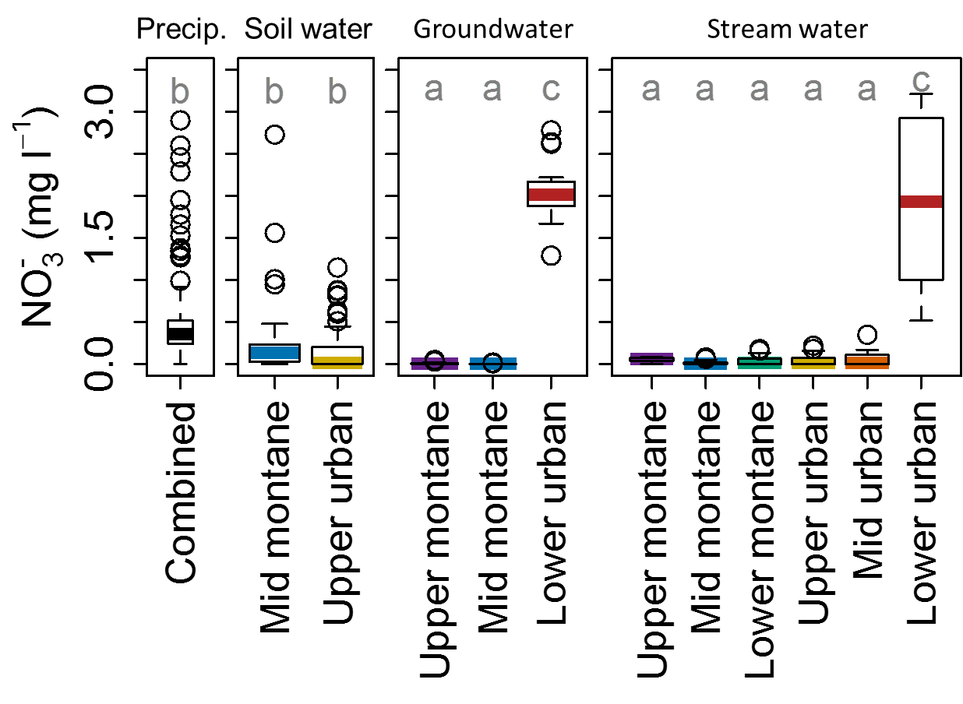
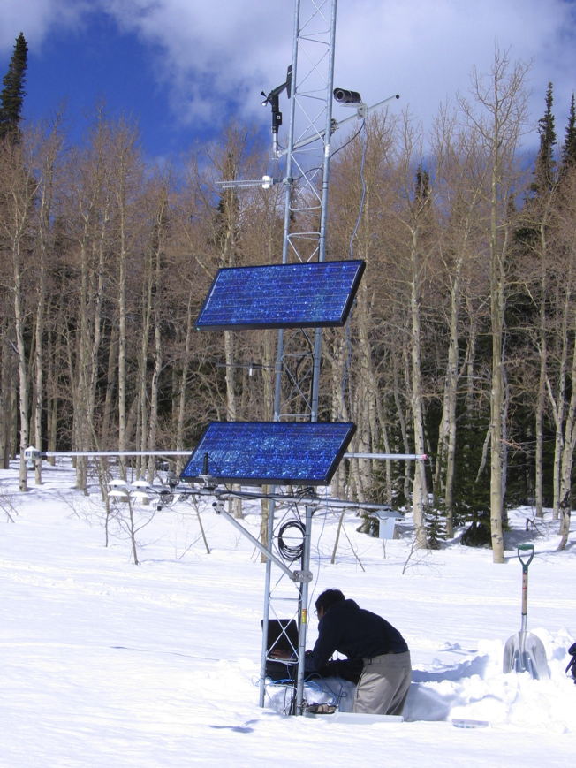
Water Quality Research in iUTAH
Exploring spatial patterns of water quality from mountain to urban gradient
Notes:
Nitrogen dynamics

Slide 16
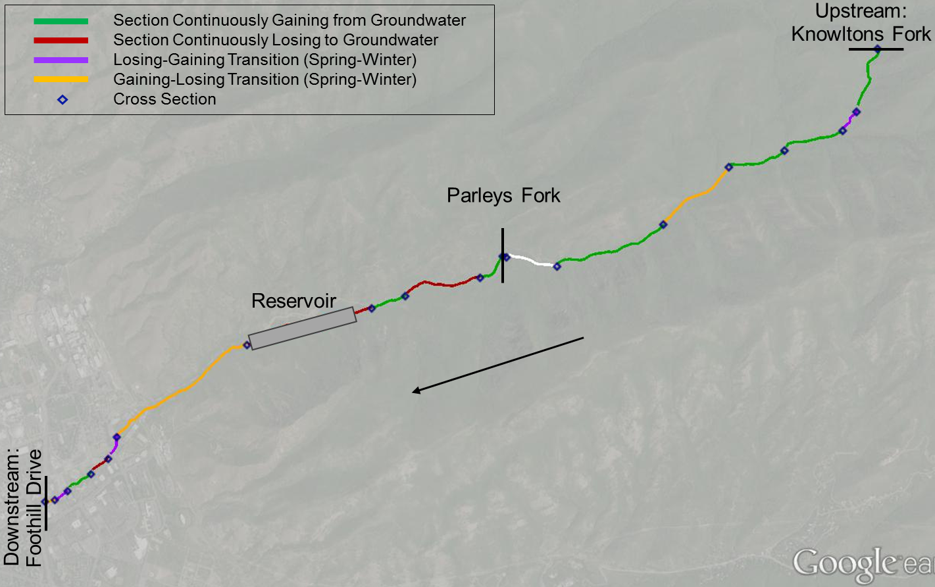
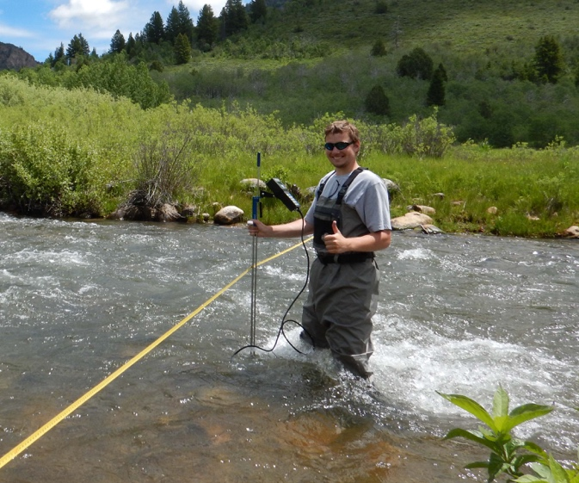
Water Quality Research in iUTAH
Notes:
Beth Neilson’s research group has been working to combine instream flow and chemical measurements to understand longitudinal trends in chemistry and the role of groundwater exchanges.

Slide 17
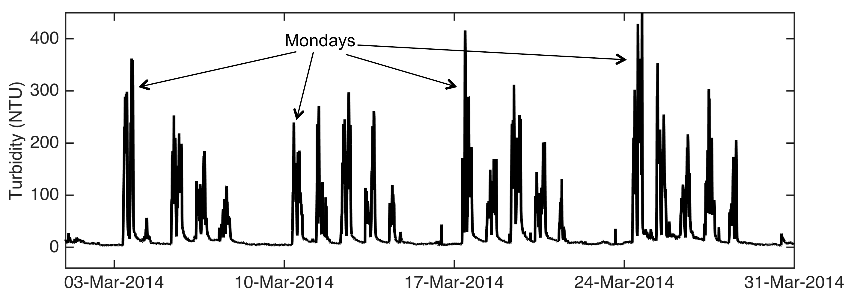
Water Quality Research in iUTAH
Notes:
A vignette of GAMUT data: in situ turbidity in Logan River passing through Logan City. Construction underway to deepen channel and stabilize streambanks. Turbidity shows the disturbance during weekday working hours.
Rapidly identify water quality events and potential to identify human-induced changes.

Slide 18
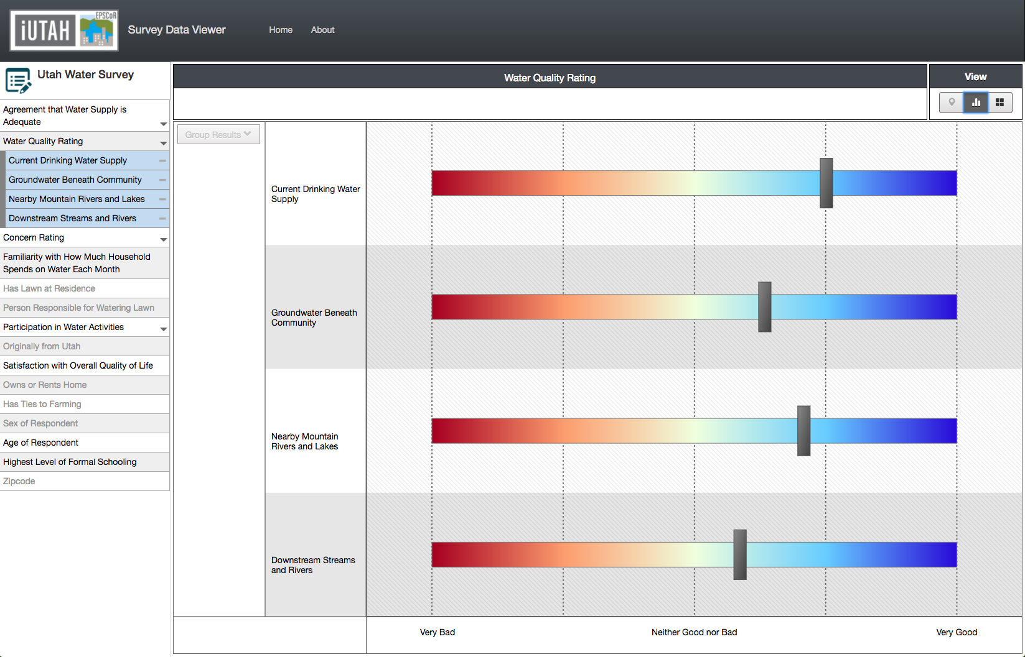
Water Quality Research in iUTAH
Notes:
Side note: iUTAH also includes social scientists who have used surveys and interviews to assess public perceptions of water quality

Slide 19
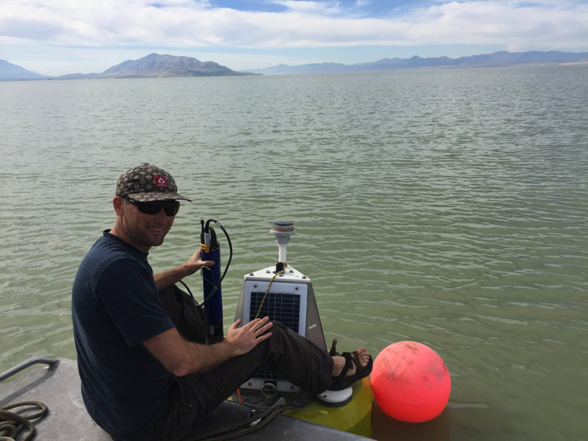
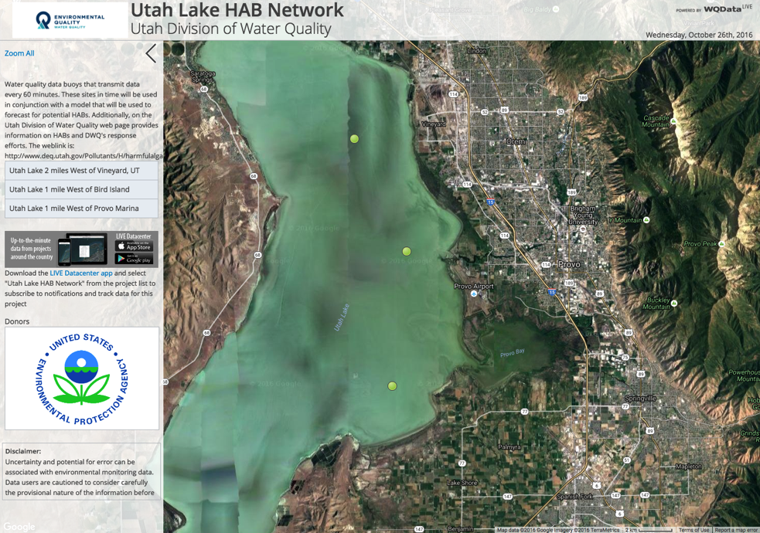




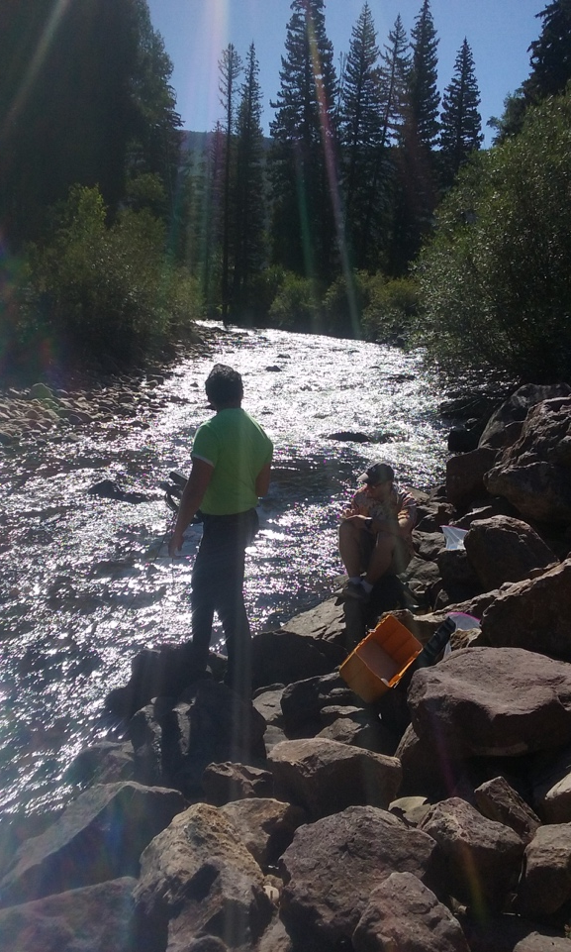
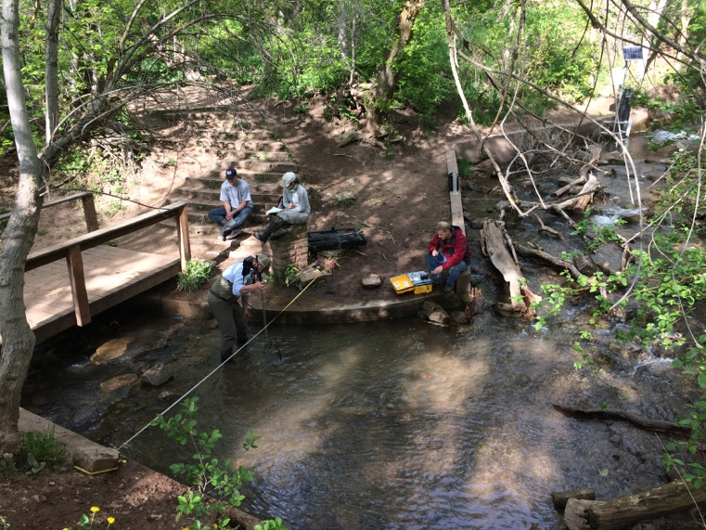


www.iUtahEPSCoR.org
Notes:
To find out more, please visit us at www.iUtahEPSCoR.org.
Not only are we collecting interesting and relevant wq data to understand wq issues in UT, here are students coming out of our program with skills- trained and available to agencies like yours.
We’re in the process of writing new proposals and building new work off of this infrastructure- there is potential for looking at water quality in new and interesting ways. We learn a lot from high frequency data that we don’t get through traditional sampling
The mountain to urban gradient is a unique transect and relevant to many of Utah’s watersheds and population centers.
Opportunities for others outside of iUTAH to use these data- open, available. The data are of high value given the investment in quality control.
Data may be relevant to WQ assessment purposes, etc.
GAMUT represents a model for other networks or other types of future infrastructure. Mention GAMUT paper- it’s in review- we’ve documented important steps for establishing a network like this.
For example, we’ve applied lessons from GAMUT to a partnership with Utah DWQ to get monitoring equipment deployed on Utah Lake and set up data streaming, access, and management.
Are there research questions that you have, which we could answer with this infrastructure? That’s a conversation that we would love to have.

Slide 20












GAMUT Extensions: Biophysical Research
Notes:
Not only are we collecting interesting and relevant wq data to understand wq issues in UT, here are students coming out of our prgoram with skills- trained and available to agencies like this.
Steven Hall: has published the results of his studies focused on Nitrogen dynamics in soil, water, snow, and riparian areas in GAMUT watersheds.
Erin Jones: Is studying bacterial communities within GAMUT watersheds- particularly how they change along the mountain to urban gradient.
Beth Ogata: performed nutrient and pharmaceutical addition experiments to test how these pollutants impact the structure and function of stream biofilms. She used GAMUT water quality and climate data to understand how various environmental factors influence this process.
Julie Kelso: has been analyzing water samples to characterize organic matter in all three watersheds and the Jordan River and to identify terrestrial, instream or urban sources. She plans to use dissolved oxygen data to model metabolism.
Rachel Gabor: is focused on identifying how water chemistry changes in the urban system and what flowpaths transport solutes to the stream. Rachel led multiple synoptic surveys to collect samples, and she is using sampled results and discharge to identify urban and canyon end members.
Beth Neilson’s research group has been working to combine instream flow and chemical measurements to understand longitudinal trends in chemistry and the role of groundwater exchanges.

